Slide 1


\
Request for Proposals is Open
TCU Building Bridges Grant Program
A Science, Technology, Engineering & Math (STEM) grant-funding opportunity developed in partnership with the American Indian Higher Education Consortium (AIHEC) and the National Aeronautics and Space Administration (NASA)
Workshop:
Building a Competitive Proposal
Notes:
Drop Link in the Chat

Slide 2


Today’s Agenda
Welcome
Building a Competitive Proposal
Discussion and Questions
Closing & Next Steps

Slide 3

Timeline
& Overview
\
Each cycle, 4 webinars will be offered to support the proposal development process.
1 – Information Session + Q & A (60 Min)
2 – Workshop: Community of Practice (June 21)
3 – Workshop: Building A Competitive Proposal (June 28)
4 – Workshop: Budget Development (July 15)
5 – Office Hours: Monday, August 6th
*Webinars will also be recorded and uploaded to AIHEC.org for review
TCU faculty and staff who are interested but are not ready to submit a project are encouraged to attend workshops and learn more about the program, then submit an application for a future cycle.
Notes:
In today’s Workshop, we’ll be discussing the Narrative piece of the proposal – our next Workshop will cover Budget and Budget Narrative development.
Note: 8/6 will be our final Workshop - ‘Office Hours’. This will be an opportunity for you to come in and ask any last-minute questions you may have. This is scheduled 1 week before submission date of 8/12.

Slide 4
RFP Overview - FAQ
RFP RELEASE DATE: June 17, 2024
PROPOSAL DUE DATE: 11:59 PM Eastern Time (ET) August 12, 2024
FUNDING AMOUNT: Multiple awards of up to $68,600 are available ($686,000 total each year)
ELIGIBILITY: Funds are available to faculty led teams from all accredited Tribal Colleges & Universities
ESTIMATED CONTRACT PERIOD: September 16, 2024 through September 16, 2026, or up to 2 years (24 months) from date of award, depending on the scope of the project. Projects designed for shorter periods of time will receive equal consideration. If projects last 1 year or less, projects can be renewed for a second cycle with an additional award.
Notes:
Review this.

Slide 5
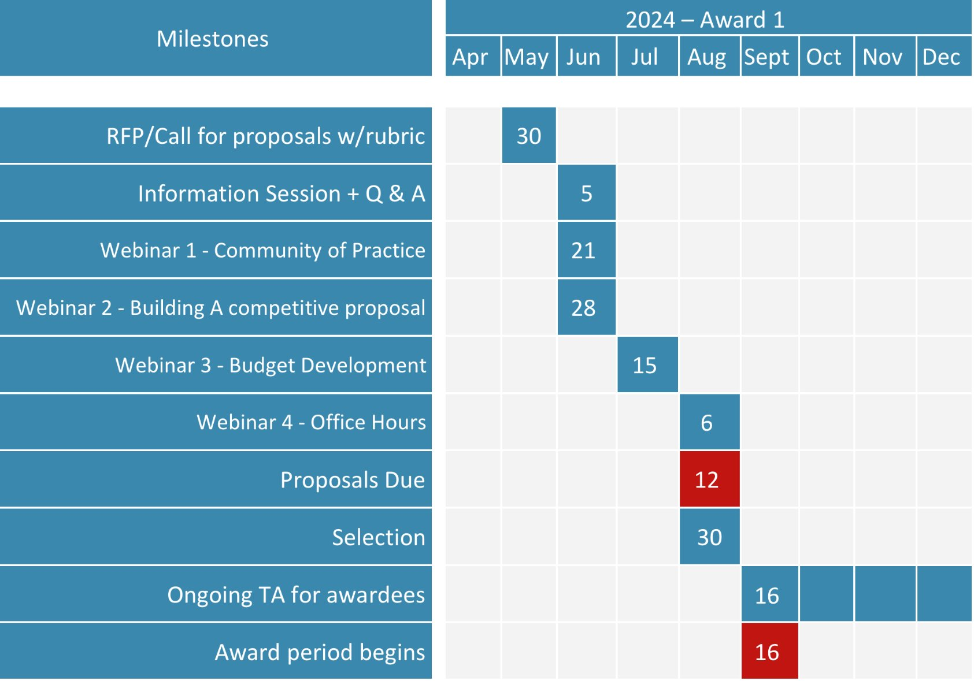
Timeline
& Overview
\

Slide 6
Proposal
Goals
\
Proposal Goals
Project must meet at least two of the three programmatic goals
1. Increase the number of Tribal College students engaging in STEM research and education activities. (Examples: internships, externships, Experiential Learning Opportunities (ELOs), Research Experiences for Undergraduates (REUs))
2. Increase the enrollment of Tribal College students in STEM degree programs and pursuing STEM career pathways.
3. Strengthen the capacity of the Tribal College to deliver STEM courses, degrees and curriculum.
AND
Demonstrate alignment to at least one of the three strategic goals
1. Strategic Goal 1.0: Create unique opportunities for a diverse set of students to contribute to NASA’s work in exploration and discovery.
2. Strategic Goal 2.0: Build a diverse future STEM workforce by engaging students in authentic learning experiences with NASA’s people, content and facilities.
3. Strategic Goal 3.0: Attract diverse groups of students to STEM through learning opportunities that spark interest and provide connections to NASA’s mission and work.
Notes:
Proposal Goals are in keeping with the overarching goal of the TCU Building Bridges Grant program to enhance the ability of TCUs to provide high quality STEM education programs, participate in collaborative STEM research initiatives, and ensure the inclusion of American Indians and Alaskan Natives in a well-prepared NASA STEM workforce.

Slide 7
Proposal Goals
&
Priority Areas of Support
\
Priority Areas of Support
  Research experiences for undergraduates (REUs)
  STEM program instrumentation/equipment acquisitions
  Course and curriculum enhancements (new courses, delivery support technologies)
  Professional development for TCU faculty, undergraduate, and graduate students, including conferences and workshops
  In person, hybrid or virtual NASA Internships for TCU students which must be funded at the same level of set NASA Intern cost amounts, as shown in the tables
Notes:
If you’re trying to decide if your idea for a project aligns with the RFP, here are some things to consider. Or, if you know you want to improve the STEM program at your TCU and need an idea for a proposal, the Goals and Priority areas of support is a good place to start. Priority Areas of Support are in keeping with the overarching goal of the TCU Building Bridges Grant program to enhance the ability of TCUs to provide high quality STEM education programs, participate in collaborative STEM research initiatives, and ensure the inclusion of American Indians and Alaskan Natives in a well-prepared NASA STEM workforce.

Slide 8
Read the RFP! Follow it exactly!
  Read the RFP Requirements and Guidelines
  then read them again and follow them exactly!
  take note of page and word limits
Think about the Quality of your ‘Idea’ and its appeal to funder
  refer to the RFP’s ‘Priority areas of Support’
  Respond to all Sections of the RFP
\
Notes:
Before writing your proposal….please read the RFP – NASA is very specific in what they want to see in a proposal and lays out their requirements very clearly.

Slide 9
Create a
Meaningful Title & Abstract
Section 1 – Project Title & Abstract
Title is important
it should convey what the project is about
Abstract (done last)
should be able to stand alone
pull content from Sections 1-3 + additional
you may be able to use same abstract in your pre-application
\
Notes:
The Abstract should be done last – we’ll circle back to this.

Slide 10
Turning your Idea into a Fundable Proposal
Section 2: Engaging Community and Building Capacity
Learning Outcomes
Discuss how this project will impact your TCU and community.
For example:
  If students are working on the project, what knowledge or skills will they obtain?
  How many students will the project support and impact?
  Will they receive course credit?
  How will this project support their successful entry into a STEM career in the future?
\

Slide 11
Turning your Idea into a Fundable Proposal
Section 2: Engaging Community and Building Capacity
  Alignment
Describe contribution to larger TCU or department mission and goals. Clearly demonstrate how this project will address two of the three stated NASA AIHEC Bridges programmatic goals.
Clearly demonstrate how this project advances existing goals for STEM within your TCU’s department, division, team, and/or office.
Demonstrate alignment to at least one of the stated NASA Office of STEM Engagement Strategic Goals.
  Project Staff
  Biographical Sketches – (1) para on each staff member – why they’re qualified to do the work.
  PI - robust CV
\

Slide 12
Turning your Idea into a Fundable Proposal
Example: Engaging Community & Building Capacity
  Michael at TCU A has a project he wants to propose. A cohort of 10 students doing research, lab work, and field testing to gain the experience needed to qualify for NASA internships. This project aligns with TCU A’s strategic plan of building a STEM workforce. Outcome: Students are chosen for paid internship positions at NASA. This project results in highly skilled STEM professionals who take their skills and knowledge back to their communities and make a tangible impact.
  This checks all the boxes for Learning Outcomes’ content – tells how aligns with TCU STEM goals and impacts communities, aligns to Programmatic Goals 1 & 2 and Strategic Goals 2 & 3 and advances.
\

Slide 13
Turning your Idea into a Fundable Proposal
Section 3: Creating the Story
Landscape Discussion/Statement of Purpose
Discuss the current state of the field in relationship to your area of interest, including what needs may exist in the field or areas that are underexplored.
Describe the overarching goals of the project, specifically addressing the question: “What learning, community, institutional or research gaps in the STEM field does this project seek to fill”?
\

Slide 14
Next
Workshop
Section 4: Building the Scaffolding
Budget Narrative & Budget Table
Next Workshop - ‘Budget Development’
Monday, July 15th
\

Slide 15
Plan your Timeline
Section 5: Planning & Implementing
Implementation timeline
Provide a detailed timeline for the project, including anticipated key dates for milestones, deliverables, and other important project tasks. The timeline can be written or represented visually.
\
Notes:
Bolded words – the RFP requires that each of these be included in the Planning & Implementing Section of the proposal.

Slide 16
Tell your Story
Section 5: Planning & Implementing
Storytelling
Discuss how the project will deliver any final products such as reports, media or presentations
Describe how such deliverables may be shared with other TCUs, the broader research community, or general public.
Note: If no tangible products are being developed, video or audio logs and diaries are acceptable.
Include clear metrics of success for the project along with a simple evaluation plan. It is important to be able to demonstrate evidence of success in reaching stated goals.
\

Slide 17
Tell your Story
Abstract
Now you have all the pieces you need to write your abstract:
Example (single paragraph)
The Reactive Rover program seeks to train pandemic puppies who were isolated and require the social skills needed to interact well with other dogs and humans. (Title, Section 3 Landscape/purpose)
Puppies that graduate from an intensive six-week course will be well-behaved, calm and interact positively in a variety of settings. (Section 2 - Outcomes)
This one-year project will be led by Kathy (PI) and John at TCU A, in partnership with trainers from Hound Around academy. (Section 1 – Who and how long)
\
Notes:
Now you all the pieces you need to write your abstract.

Slide 18
The Abstract is your Project’s Elevator Speech
\
Abstract
Include in Project Abstract
Name of your TCU
    Principal Investigator(s) – staff member leading the project
    Co-Principal Investigator(s) – project co-lead(s)
    Collaborators and Partner Institution(s) – names and titles or individual collaborators or partners and/or the names of collaborating/partnering institutions and organizations (optional)
Project Duration – The estimated duration of your project
Notes:
The Abstract should be done last – we’ll circle back to this.

Slide 19

Turning your Idea into a Fundable Proposal
Best Practices
When writing - Write to the Funding Source using Professional Language
  never use jargon
  never write in 1st person
  write with clarity – no fancy language or complicated sentences
  don’t use language that is biased
  respond to all Sections
  adhere to formatting restrictions – page limitations
  topics must be covered in order presented in Guidelines
  use Headings that correspond to the Guidelines
\

Slide 20
Turning your Idea into a Fundable Proposal
  Write to Persuade
          use current data from a reputable source
          establish credibility – present your case honestly and with integrity
          no unsubstantiated opinions – don’t make statements that can’t be proven
  Project and Plan communicated clearly and concisely
  RFP uses the descriptor ‘detailed’ throughout
  Ask Questions!
\

Slide 21
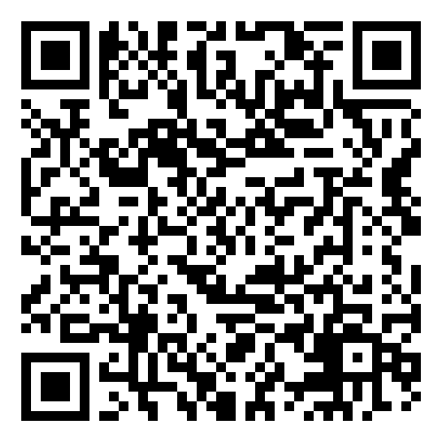
\
Thank you for coming!
Please complete our survey:
We will come back together
Monday, July 15th to review
Budget Development
Notes:
https://app.smartsheet.com/b/form/d7b1cc948a424d849d977da80b65758e

